Slide 1
FOOD ADULTRATION

Slide 2
CONTENTS
ABSTRACT
KEY POINTS TO FIND FOOD ADULTRATION
SOLUTION
PROPOSED METHODOLOGY
RESULTS
CONCLUSION

Slide 3
ABSTRACT
Food adulteration is addition of a non-food item to increase the weight/quantity of the food item in raw or prepared form, which may result in the loss of actual quality of food item.
The addition of inferior or harmful substances to food products, either intentionally or unintentionally, for the purpose of increasing profits, enhancing appearance, or extending shelf life.
This unethical practice poses a significant threat to public health and safety, as it can lead to various health issues and even fatalities in severe cases.

Slide 4
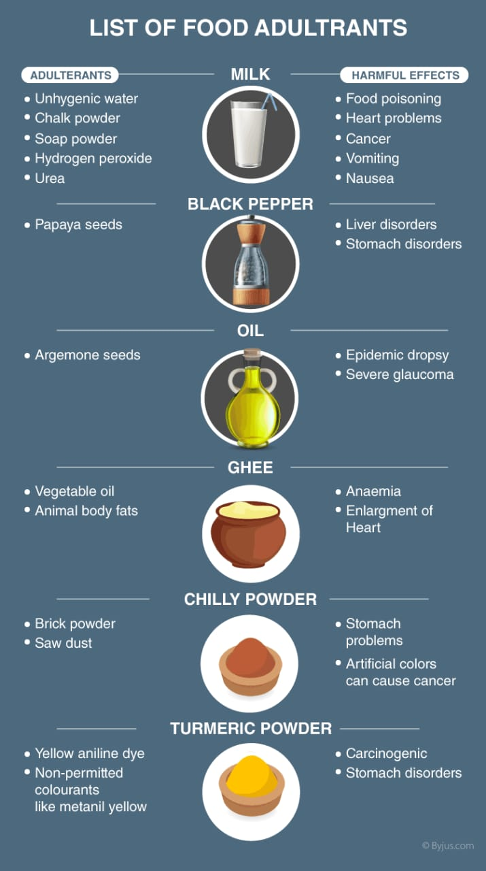
ABSTRACT

Slide 5
Key points of the problem statement:
Public Health Hazard:
Some common health problems caused by food adulteration include food poisoning, gastrointestinal disorders, allergies, and long-term chronic diseases.
Consumer Deception:
Consumers may unknowingly purchase adulterated food, believing it to be genuine, safe, and of higher quality.
Producers who engage in adulteration gain an unfair advantage by reducing production costs, leading to a price advantage over genuine products.
Economic Impact:
Loss of Trust:
This lack of trust can lead to a reduction in food consumption, decreased revenue for legitimate food businesses, and overall skepticism about food safety measures.
Regulatory Challenges:
Detection of adulterants often requires specialized testing equipment and trained personnel, making it difficult to identify all instances of food adulteration.

Slide 6
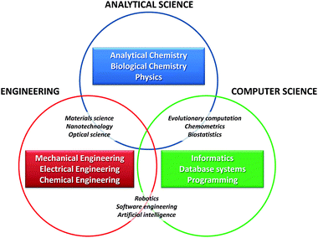
SOLUTION
Addressing the problem of food adulteration requires a multi-faceted approach that involves various stakeholders working together.
On the other hand, by passing and implementing strict food safety laws and regulations, governments can prevent food adulteration.

Slide 7
METHODOLOGY
There are many methods to detect food adultration but mainly it depends on the materials used
Detection Of Removal Of Fat By Skimming – Ghee
Detection Of Starch – Cereal flours
Detection Of Cane Sugar – Cane sugar
Detection Of Urea – Fertilizers
Detection Of Neutralizers In Milk - Milk
Detection Of Glucose - Glucose

Slide 8
RESULTS
Improved Public Health:
Enhanced Consumer Confidence:
Reduced Economic Impact:
By reducing the prevalence of food adulteration, the number of foodborne illnesses and health issues caused by consuming adulterated food will decrease.
As the risk of purchasing adulterated products diminishes, consumers will gain greater trust in the food they purchase.
Food adulteration can have a negative economic impact on both consumers and legitimate food producers by curbing adulteration.,

Slide 9

RESULTS

Slide 10
CONCLUSION
Food is the basic need for life. Without food there is no life.
Food adulteration is a inhuman act by vendors for the sake of profit.
which is a big threat to human society. The adulterants effects the health of the people seriously.
There us an underlying need for increasing the number of food testing laboratories with highly useful chemical analysis methods.
The adulteration can also be bring down by educating the public to identify adultration.

Slide 11

THANKS !!!

